Slide 1
BATH ALPHABETICAL QUIZ
BY HZ

Slide 2
One of the most impressive buildings of the city is the bath A……………..
ABBEY

Slide 3
A SPECIAL SWEET ROLL WITH SUGAR INSIDE IS CALLED BATH B……….
BUN

Slide 4
A VERY TYPICAL PIECE OF ARCHITECTURE IS DUE TO ITS SHAPE CALLED C…..
CRESCENT

Slide 5
THE Briton tribe which lived in this area was called D…………
DOBUNNI

Slide 6
HOARD -MORE THAN 30,000 COINS WERE E……NEAR THE BATHS
EXCAVATED

Slide 7
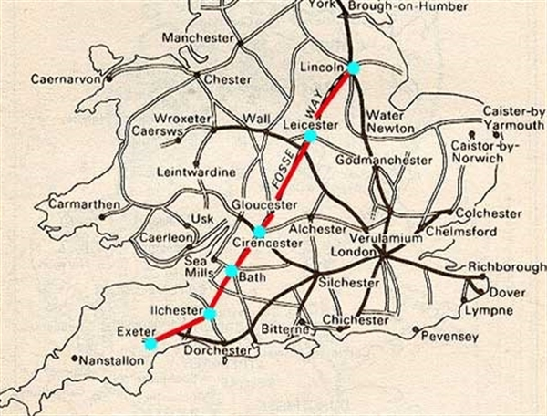
AN OLD ROMAN ROAD MEANING THE ROAD IN THE DITCH(SCHOOL) F….
FOSSE WAY

Slide 8
THE MOST SPREAD TYPE OF THE ARCHITECTURE IS THE G…………..
GEORGIAN

Slide 9
THE BATH FIRST PUBLIC ART GALLERY CALLED AFTER ITS COLLECTOR-h…
HOLBURNE
MUSEUM

Slide 10
THE AREA WAS INHABITTED DURING THE I…..AGE
IRON

Slide 11
THE CITY IS CONNECTED WITH A VERY FAMOUS FEMALE WRITER-j……
JANE
AUSTEN

Slide 12
THE CIRCULAR SHAPED HOUSES WITH ARE CALLED THE K….. CIRCUS
KING´S

Slide 13
MOST OF THE HOUSES ARE MADE OF A BATH STONE (A KIND OF THE) L…..STONE
LIME

Slide 14
THE ROMANS WORSHIPPED HERE THE GODDESS OF WISDOM CALLED M….
MINERVA

Slide 15
A VERY FAMOUS DANDY AND THE MASTER OF CEREMONIES FROM BATH WAS BEAU N…..
NASH

Slide 16
ORIGINALLY A CHURCHYARD, NOW A PARADE OF INDEPENDENT SHOPS-O….
ORANGE GROVE

Slide 17
THE VERY SPECIAL RESTAURANT STANDING NEAR THE BATHS- THE P…..
PUMP ROOM

Slide 18
A SQUARE WITH THE OBELISC IN THE MIDDLE IS CALLED TH Q….. SQUARE
QUEEN´S

Slide 19
THE BUILDERS OF THE BATHS -R……
ROMANS

Slide 20
THE RURAL COUNTY THE CITY OF BATH IS LOCATED IN – S…….
SOMERSET

Slide 21
THE SPA WAS AT THE SAME TIME A T…. OF THE GODDES CALLED SULIS
TEMPLE

Slide 22
THE CITY IN 1987 BECAME ONE OF THE U….. HERRITAGE SITES
UNESCO

Slide 23
THE PARK WHICH WAS OPENED BY 11 YEARS OLD PRINCESS IN 1830
VICTORIA PARK

Slide 24
UNDER THE PULTENEY BRIDGE YOUCAN SEE THE HORSESHOE SHAPED W….
WEIR

Slide 25
THERE IS A TRADITIONAL MARKET BEFORE X…..
X-MAS

Slide 26
ONE STREET IS NAME AFTER THE DUKE AND THE TOWN AS WELL .Y……
YORK

Slide 27
BA1 OR BA2 IS THE FIRST PART OF A POSTAL OR Z….CODE OF BATH
ZIP

