Slide 1
Job shadowing Bath 2019
Mecanser group + Erasmus 17-23 Sept.2020

Slide 2
I spent a really nice week in a beautiful town
Basic information:
Bath - the largest city in the county of Somerset
named after its Roman-built baths
The city became a World Herritage site in 1987.
Population- 88,859 people
156 km west of London and 18 km southeast of Bristol
Second visited place by the tourists in UK

Slide 3
Town- city is full of historic(al) sites
Celtic origin of the place
Roman baths dedicated to the goddes Sulis-Minerva (thermal water)
Medieval narrow streets
Bath Abbey – founded in 17th century
Georgian architecture- from 18th century from Bath stone
Used to be famous spa town
Jane Austen lived here

Slide 4
Roman Bath

Slide 5
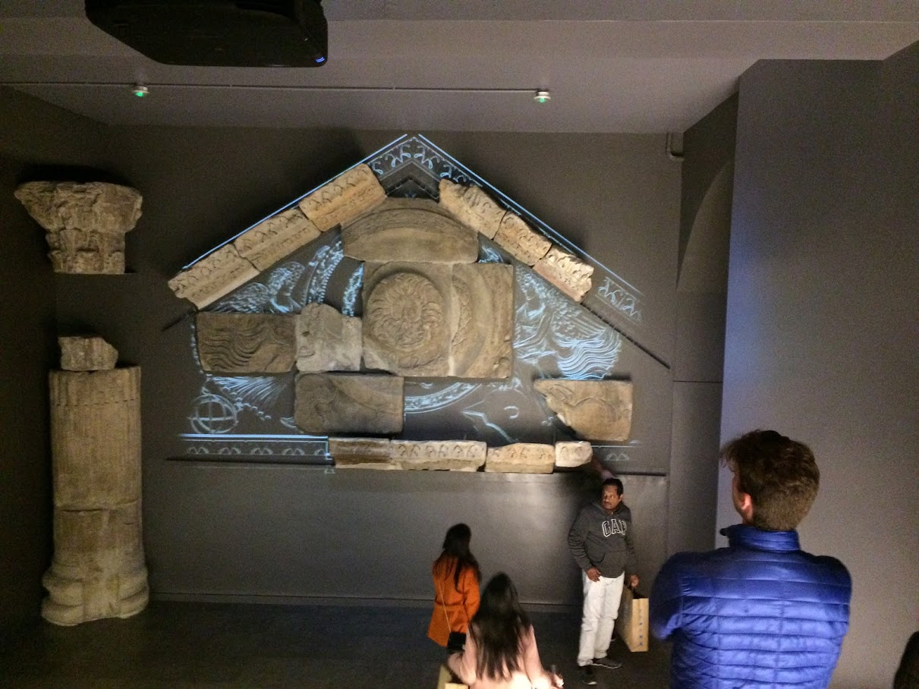
Interactive display

Slide 6
model

Slide 7
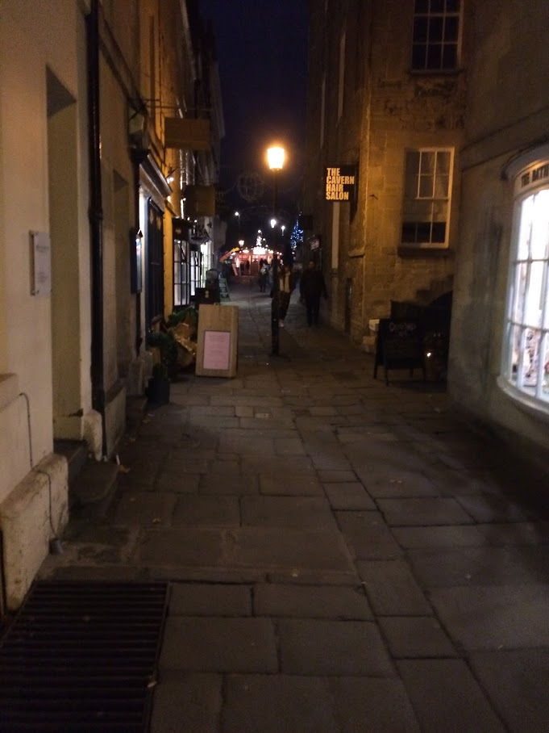
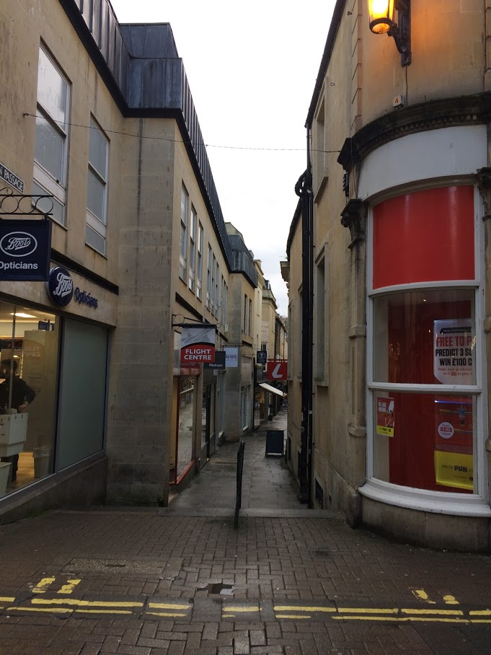
narrow streets

Slide 8
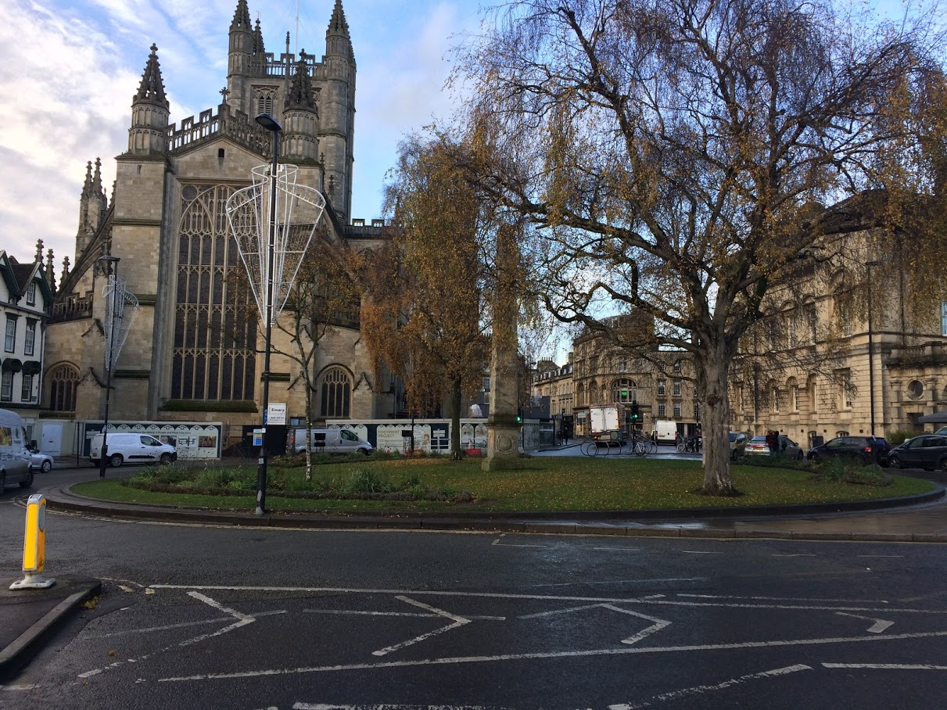
Abby

Slide 9
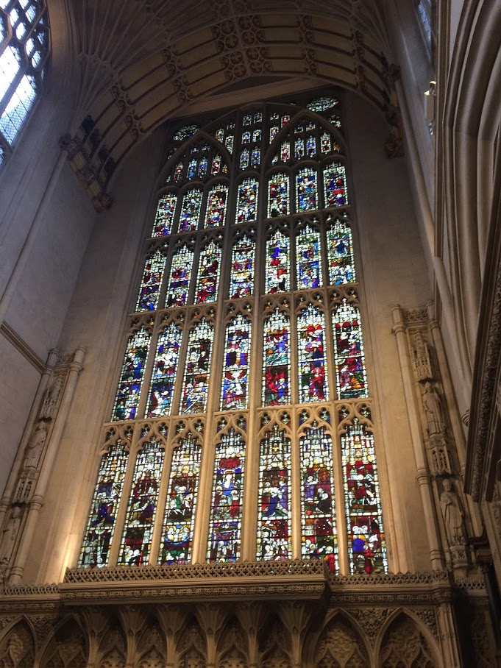
Inside the Abby

Slide 10
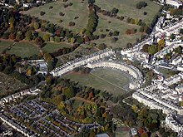
Georgian architecture- Royal Crescent

Slide 11
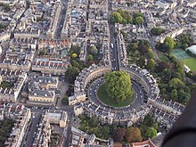
Georgian architecture- Circus

Slide 13
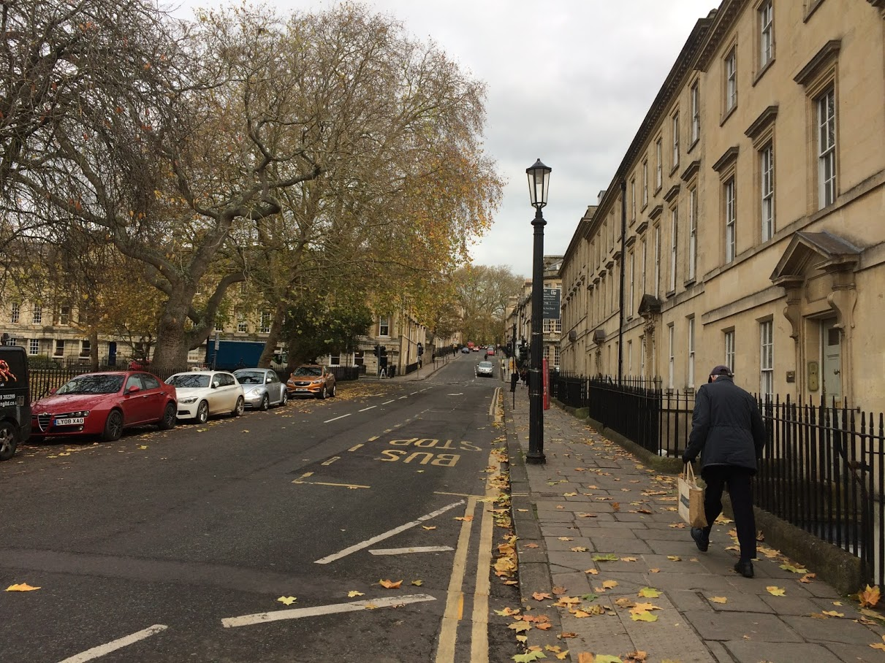
Georgian houses

Slide 14
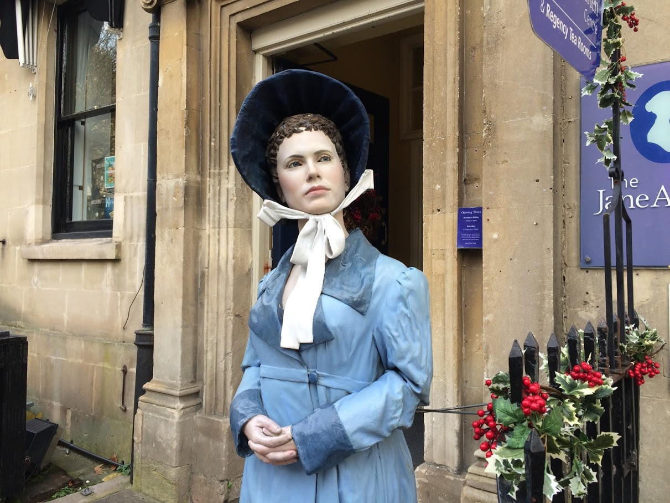
Jane Austen centre

Slide 15
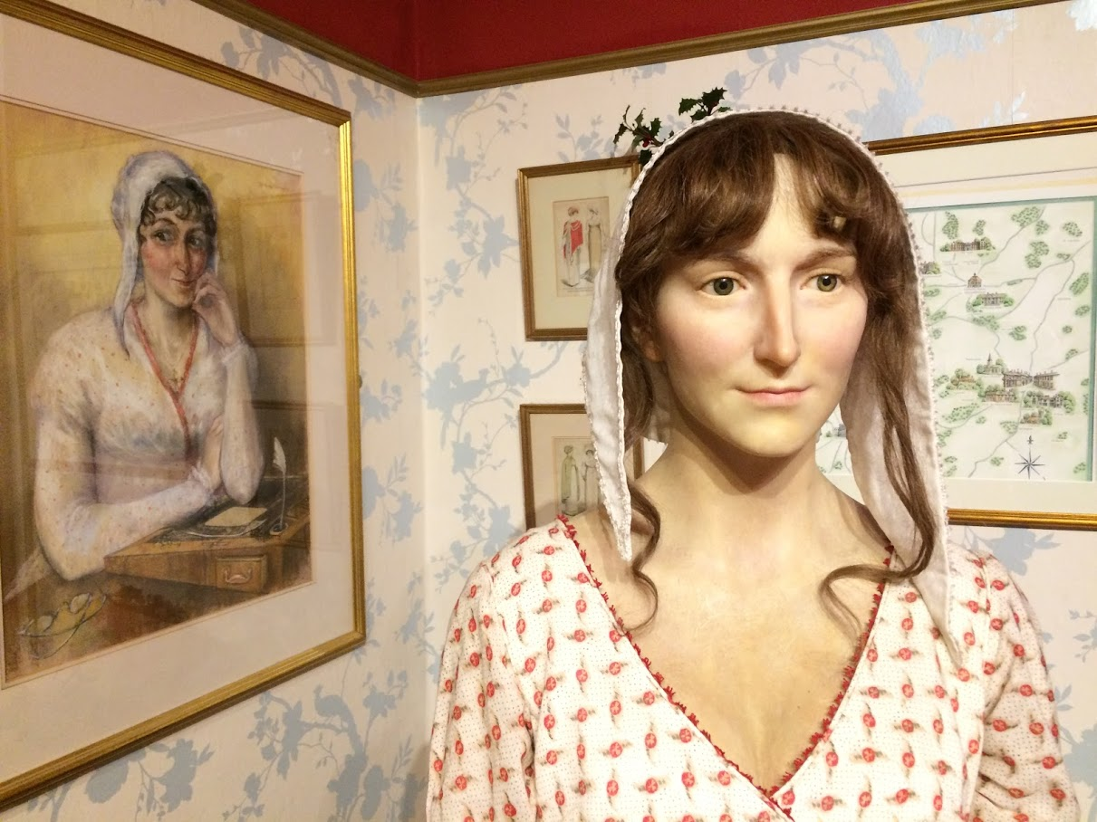
Possible appearance

Slide 16
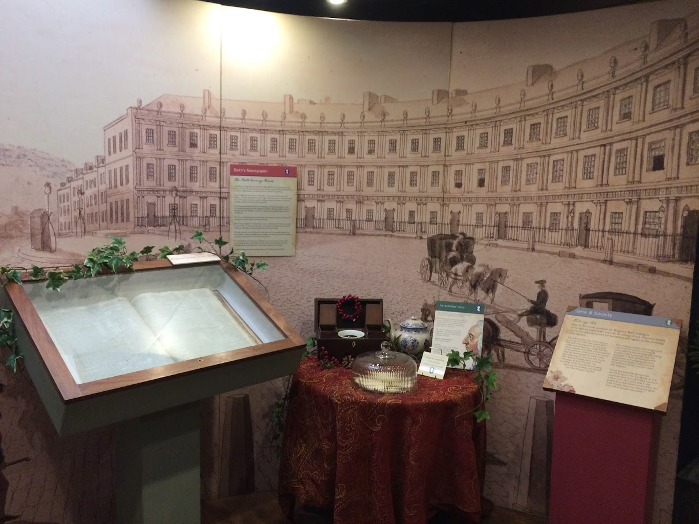
Souvenir shop, the exhibition

Slide 17
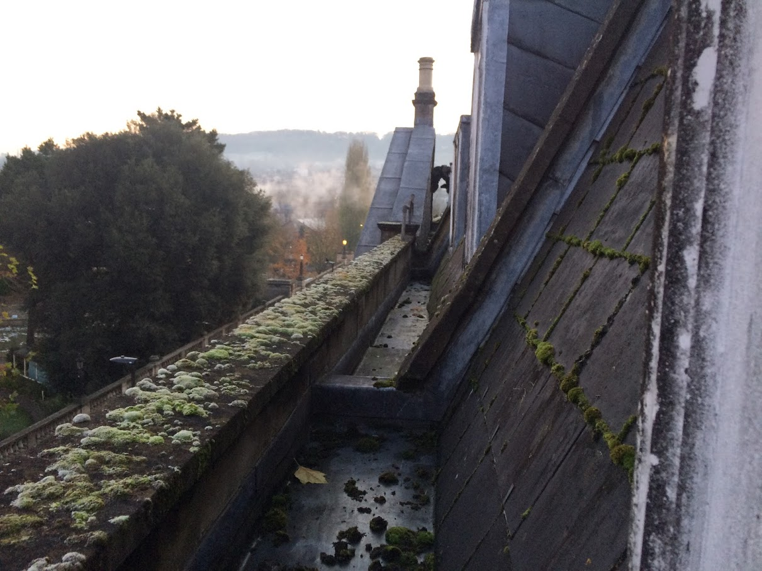
My temporary view

Slide 18
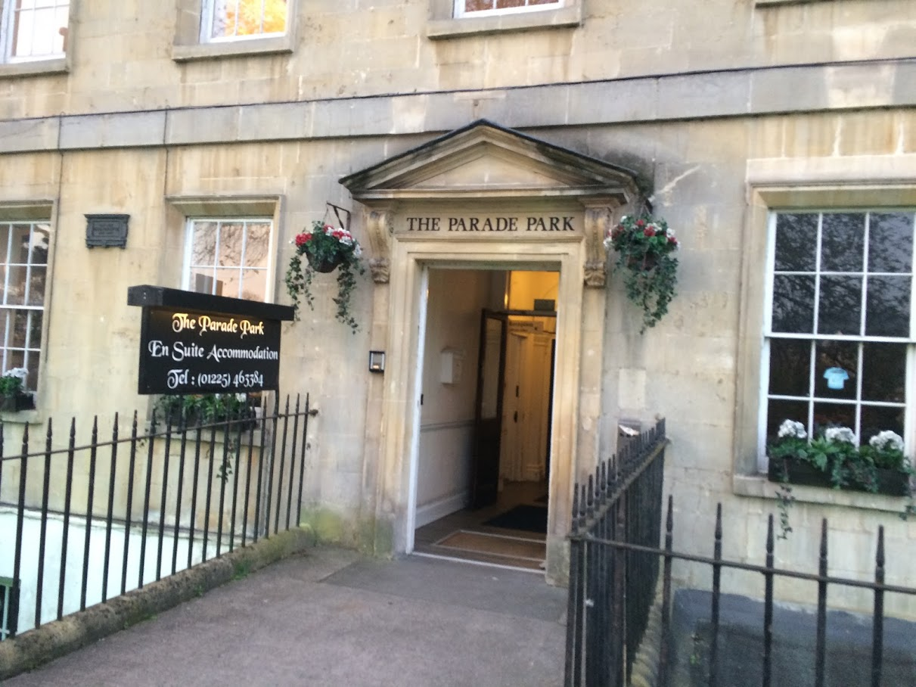
My temporary home

Slide 19
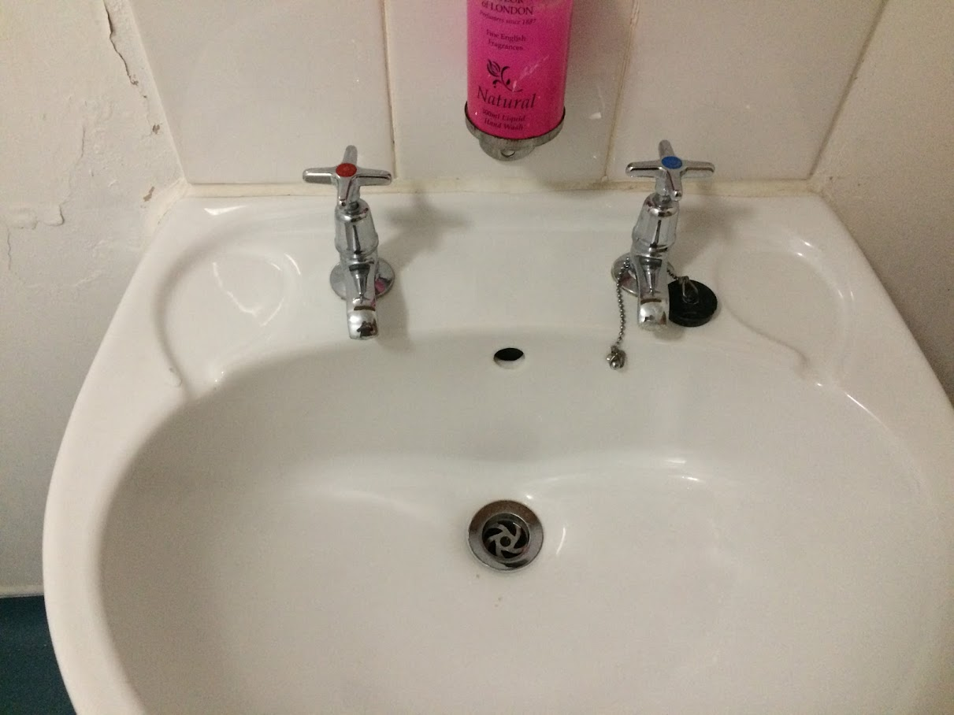
Real taste of English bathroom

Slide 20
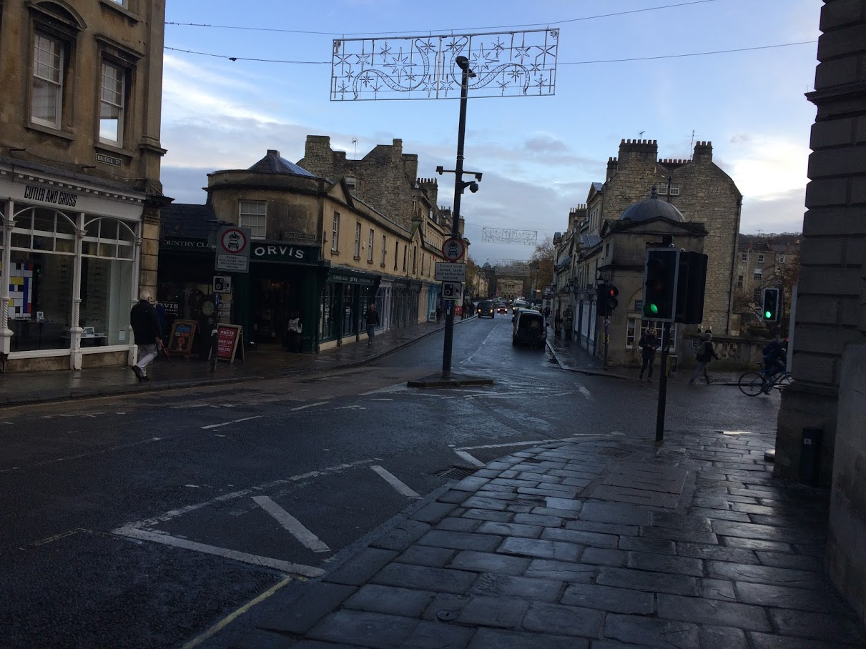
Pulteney bridge (similar to Florence Ponte Vecchio )

Slide 21
Beautiful weir on the river Avon (not that Avon, in fact avon= means river)

Slide 22
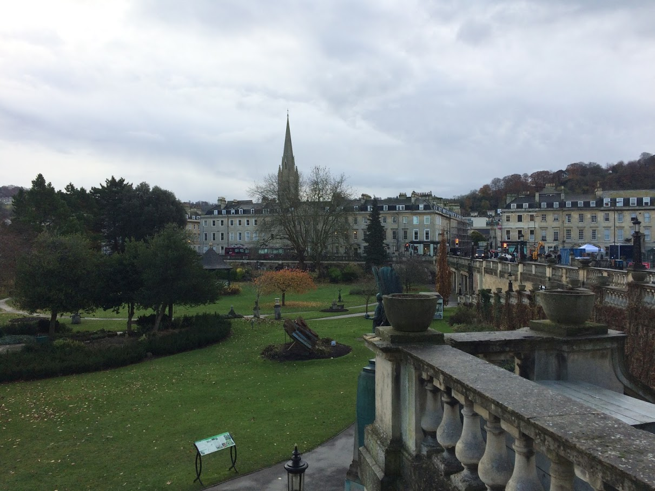
Parade garden (on my way to „school“)

Slide 23
County club – the place of the courses

Slide 24
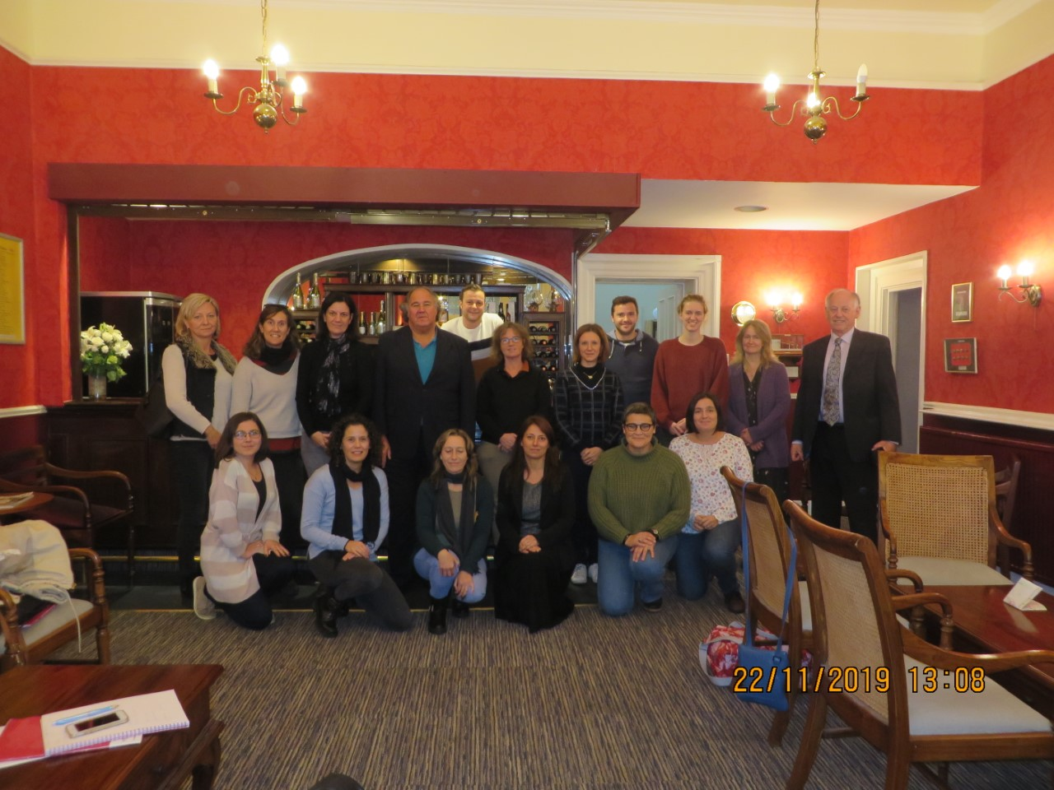
The prove…

Slide 25
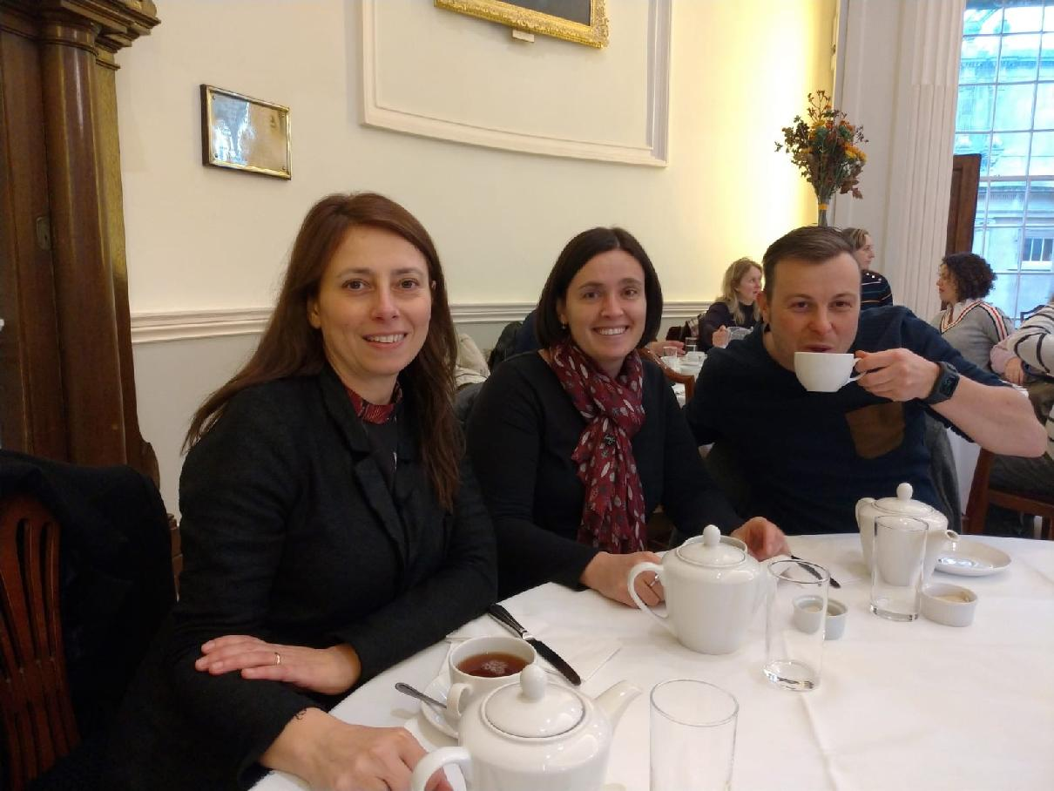
Posh Pump house – our tea

Slide 26
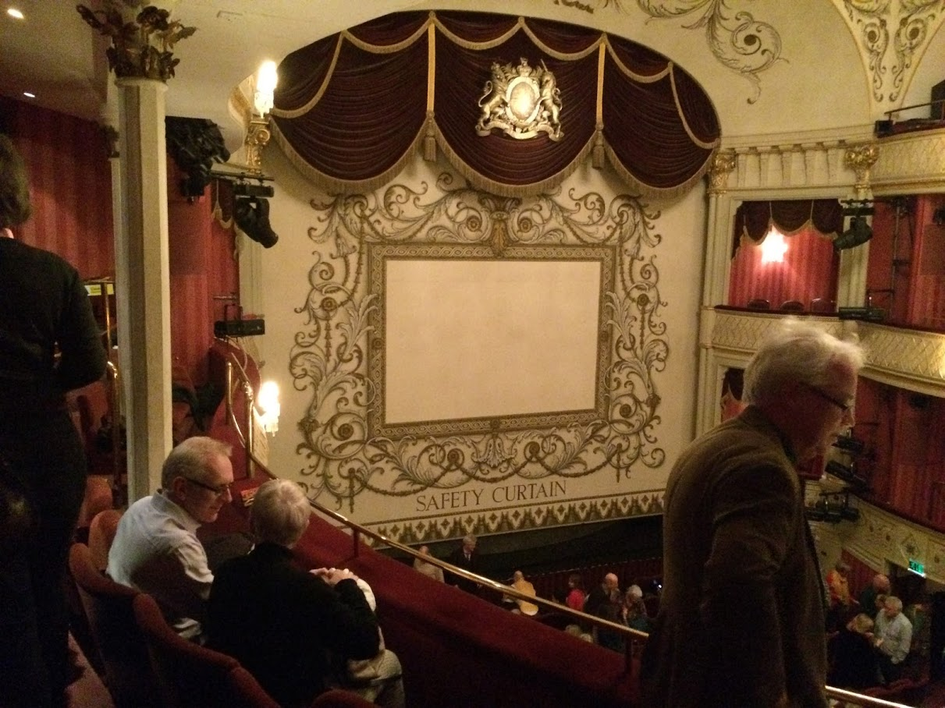
Royal theatre - Daphne du Maurier-My Cousin Rachel

Slide 27
Fosse way school – for SEND children, Special educational needs and disabilities mostly with autism

Slide 28
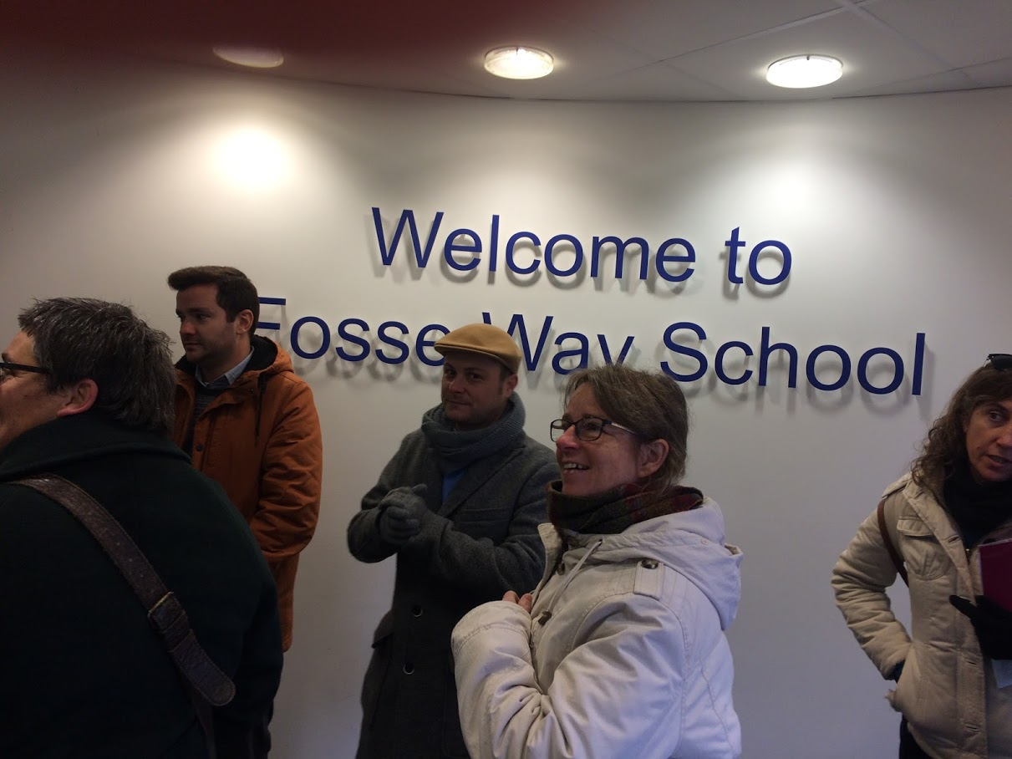
Nobody from outside allowed in without registration

Slide 29
Modern one floor building

Slide 30
Inner yard

Slide 31
Entrance to a classroom

Slide 32
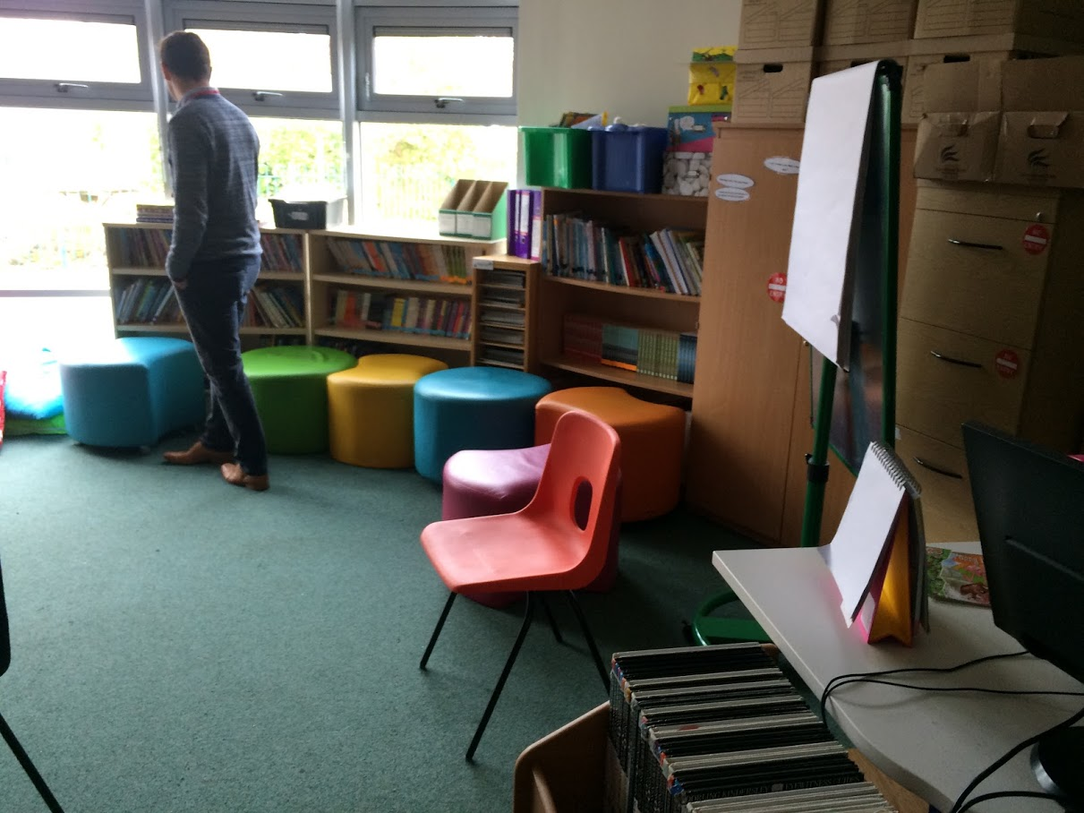
Equipment, furnishings

Slide 33
playground

Slide 34
Kitchen – school focuses on practical skills

Slide 35
School bar for everybody, students work there under supervision

Slide 36
Empty, nondistracting environment

Slide 37
Oldfield park junior school old Victorian building

Slide 38
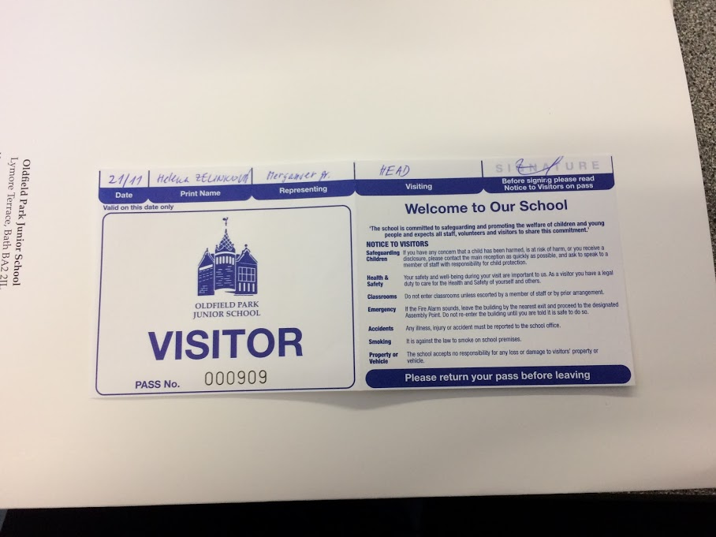
Oldfield park junior school

Slide 39
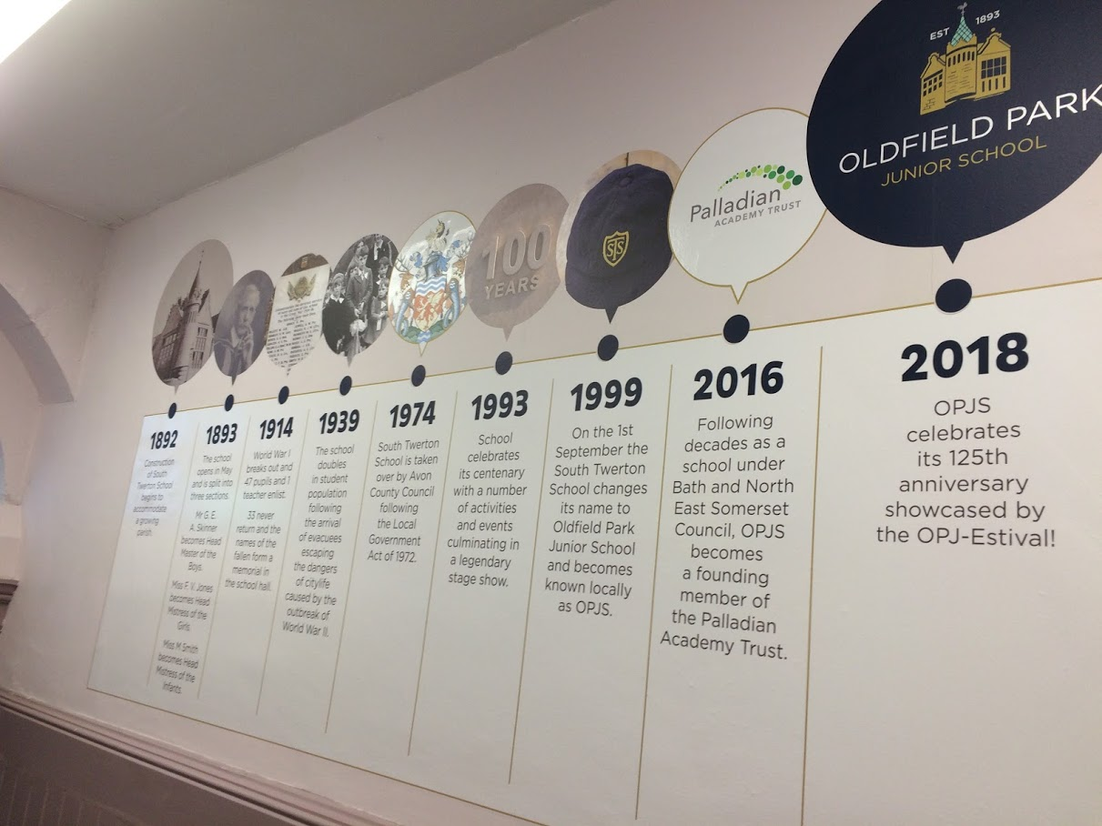
Proud of…

Slide 40
Teachers´room and the headmaster

Slide 41
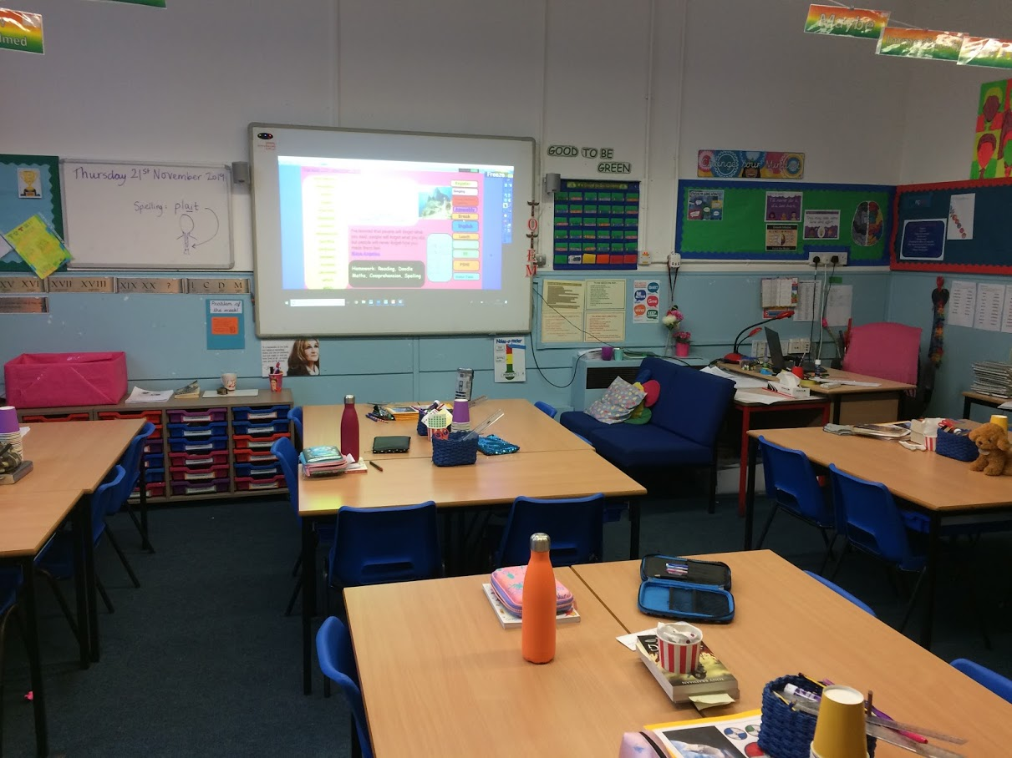
A classroom

Slide 42
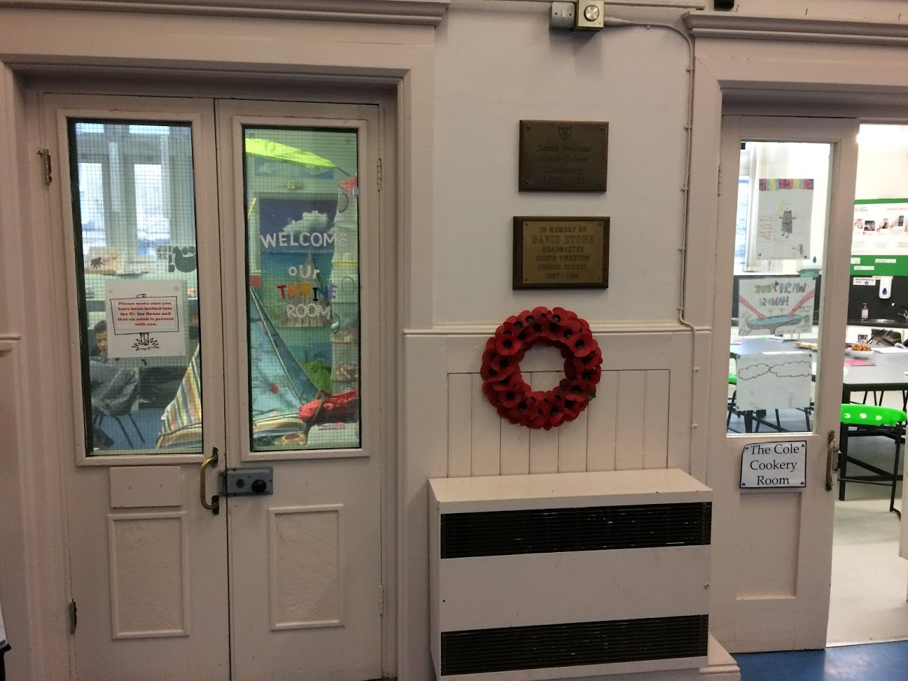
A classroom

Slide 43
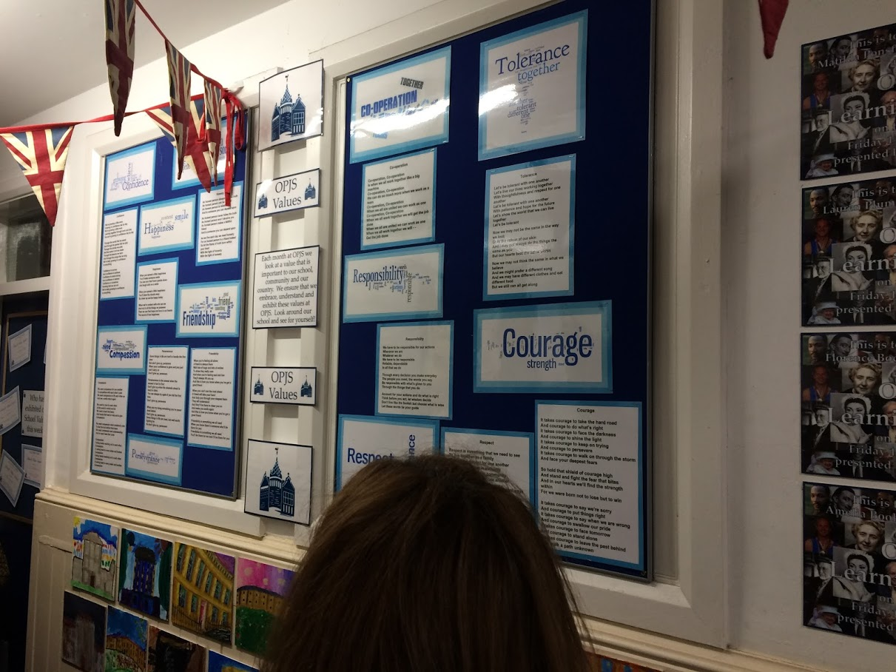
Narrow overloaded corridors

Slide 44
A library

Slide 45
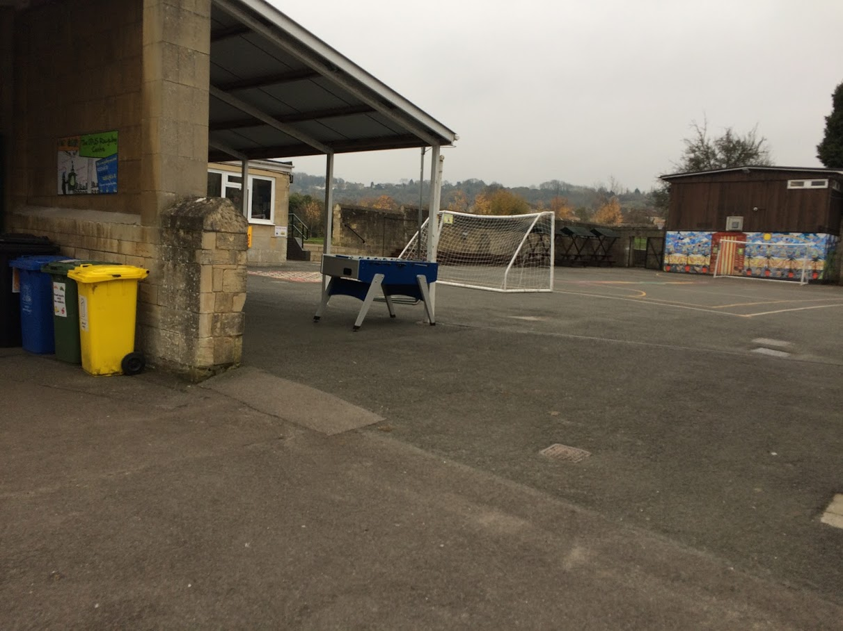
A yard

Slide 46
British system of educatin (presentation from the course)

Slide 47
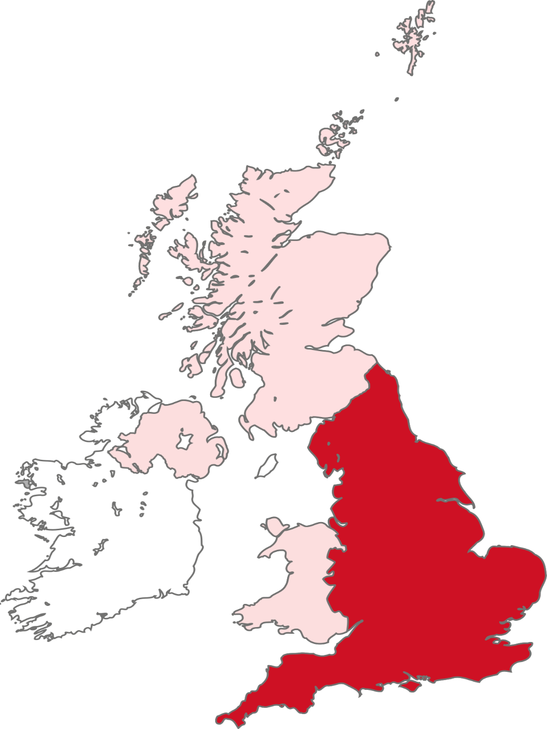
UNITED KINGDOM
Scotland
Northern Ireland
ENGLAND
EIRE
Wales

Slide 48
YEAR
AGE
20
Higher Education (University)
Further Education (College)
13
Compulsory Education ends
12
11
15
10
SECONDARY
9
8
7
6
10
5
JUNIOR
4
PRIMARY
3
Compulsory Education starts
2
INFANTS
1
5
EARLY YEARS
0

Slide 49
Education in England: Key Characteristics
Highly political
Constant change in school systems and processes
Significant private sector involvement
Senior and head teachers well paid
Huge workloads for teachers
Constant pressure for schools to perform very well
Wide variations in quality,
From the very best… To the not so good

Slide 50
England – the Structure of Education
Department for Education (DfE)
Led by Secretary of State
Maintained schools
(Funded by the state)
About 21,700 schools
Independent schools
(Privately funded)
About 2,600 schools

Slide 51
Maintained Schools
(State funded)
93% of children
Department for Education
Local Authorities
(151 in England)
Academy Trusts
(about 900 in England)

Slide 52
The English Education System: Inside Schools

Slide 53
School Management
The School Governors
The School Leadership Team
The Hierarchy for Staff and their roles
Cross curricular co-ordinators
The Pastoral System

Slide 54
YEAR
AGE
20
Higher Education (University)
Further Education (College)
13
Compulsory Education ends
12
11
15
10
SECONDARY
9
8
7
6
10
5
JUNIOR
4
PRIMARY
3
Compulsory Education starts
2
INFANTS
1
5
EARLY YEARS
0

Slide 55
YEAR
AGE
20
THE NATIONAL CURRICULUM
13
12
AGE 16
11
15
KEY STAGE 4
10
AGE 14
9
8
KEY STAGE 3
7
AGE 11
National Curriculum Key Stages
6
10
5
KEY STAGE 2
4
3
AGE 7
2
KEY STAGE 1
1
5
AGE 5
0

Slide 56
The National Curriculum - 1
 | Key stage 1 | Key stage 2 | Key stage 3 | Key stage 4
Age | 5-7 | 7-11 | 11-14 | 14-16
Year groups | 1-2 | 3-6 | 7-9 | 10-11
CORE SUBJECTS
English | ✓ | ✓ | ✓ | ✓
Mathematics | ✓ | ✓ | ✓ | ✓
Science | ✓ | ✓ | ✓ | ✓
FOUNDATION SUBJECTS
Art and design | ✓ | ✓ | ✓
Citizenship |  |  | ✓ | ✓
Computing | ✓ | ✓ | ✓ | ✓
Design and technology | ✓ | ✓ | ✓
Languages |  | ✓ | ✓
Geography | ✓ | ✓ | ✓
History | ✓ | ✓ | ✓
Music | ✓ | ✓ | ✓
Physical education | ✓ | ✓ | ✓ | ✓

Slide 57
The National Curriculum - 2
RELIGIOUS EDUCATION AND SEX AND RELATIONSHIP EDUCATION
 | Key stage 1 | Key stage 2 | Key stage 3 | Key stage 4
Age | 5-7 | 7-11 | 11-14 | 14-16
Year groups | 1-2 | 3-6 | 7-9 | 10-11
Religious education | ✓ | ✓ | ✓ | ✓
Sex and relationship education |  |  | ✓ | ✓

Slide 58
Assessment
Formative assessments (on-going).
Summative assessments:
Internal school examinations;
Reports to parents;
End of Key Stage Teacher Assessments (KS1 and KS2);
Standard Attainment Tests (SATs) at the end of Key Stages 2 and 3.
GCSEs at the end of Key Stage 4.
A Levels - AS and A2 Examinations (16+)
Baccalaureate/Vocational Courses.

Slide 59
Public Accountability
Documentation and School Self-Evaluation
School Governors – A Critical Friend?
Ofsted inspections
Her Majesty’s Inspectorate (HMIs)

Slide 60
School Inspection – Ofsted
The achievement of pupils at school
The quality of teaching in the school
The behaviour and safety of pupils at school
The quality of leadership in, and management of, the school
Spiritual, moral, social and cultural development in the school
The extent to which the school meets SEN

Slide 61
Ofsted – The Grades
Outstanding
Good
Requires Improvement
Requires Special Measures
See www.ofsted.gov.uk

Slide 62
Impact of Structural Changes
University College London Study (July 2018)
Examined Ofsted data for 10 years, statistical analysis of MATs, 47 detailed school case studies, survey of 700 school leaders
State remains in control, despite “giving more autonomy”
Better performing schools have admitted fewer poorer students
Lower status schools faced concentration of challenges
Two thirds of leaders said that inequalities between schools are becoming wider
Teacher recruitment becoming more difficult

Slide 63
Questions/Educational Issues.
Initial Teacher Education (ITE teacher training)
Career Professional Development
Behaviour management
Differentiation techniques
School self-evaluation
OFSTED Inspections
Are all subjects separate or linked by core themes?
Pedagogical strategies for Maths and English teaching
SEN pupil evaluation techniques and how to differentiate for pupils with SEN?

Slide 64
Teacher Education A Career Path

Slide 65
Teacher Education 2
Initial Teacher Education – teacher training.
Newly Qualified Teachers and Induction.
Main Scale Teachers – 2nd and 3rd year teachers
Threshold – 4th, 5th and beyond years.
Excellent Teachers.
Advanced Skills Teachers.
The School Leadership Team.
National Standards for new and experienced Headteachers2

Slide 66
The National Teaching Standards
Set high expectations which can inspire, challenge and motivate pupils.
Promote good progress and outcomes for pupils.
Demonstrate good subject and curriculum knowledge.
Plan and teach well structured lessons.
Make accurate and productive use of assessment.
Manage behaviour effectively to ensure a good safe and learning environment.
Fulfil wider professional responsibilities.
Demonstrate consistently high standards of personal and professional conduct.

Slide 67
Initial Teacher Training (ITT)
Training may be delivered in schools or other settings and is likely to include:
a combination of unobserved and observed teaching,
taught sessions, seminars, workshops, tasks and assignments, and engagement with academic/professional research.
The content of professional programmes might include, for example:
the role of the teacher
planning and assessment to ensure pupil progress
national assessments and examinations
child development and learning
Priorities, such as managing pupils’ behaviour, early reading and special educational needs and disability
assessing and evaluating teaching
the use of evidence and research to inform teaching

Slide 68
Initial Teacher Training - 2
Entry qualifications – GCSEs in English, Maths and Science plus a first degree.
Subject didactics.
Teaching and learning methodology.
ICT.
School based training practice in at least two different schools/institutions.
Full training programme in the school addressing the National Teaching Standards.

Slide 69
The Induction of Newly Qualified Teachers (NQTs)
Year 1 of a teachers’ career or pro rata if employed on a part-time basis.
Extension period possible for failing a NQT.
Three formal assessments recorded.
The responsibility of the Appropriate Body, Head Teacher and the Induction Tutor.
Observation and training activities.
Clear links to ITE and to CPD for Year 2.

Slide 70
The Induction Process
Training Opportunities
Assessment
A full Induction Training Programme specific to the school e.g. The first week at school, Policies, Practices, Pastoral, Academic Reviews, X Curricular Themes/Issues.
Observation of experienced colleagues and of NQT lessons.
Focused mentoring and coaching on a regular basis.
Meetings to discuss i)thematic basis of formal observation, ii) evaluation and review of lesson.
End of Term 2 Formal Lesson Observation and Written Statement (evidence based).
Action plan from the above.
End of Term 2 Formal observation and written statement and revised action plan.
End of Term 3 Final observation and statement to achieve full QTS and permanent employment.
New Career Path Action Plan.
Failure and Appeals.

Slide 71
How “good” is my school?
Data gathering – Internal School Exams, SATs, GCSEs, A Levels and National Qualifications.
RAISE online www.raiseonline.org – a school data comparison tool.
November 2017 – Analyse School Performance (ASP)
Pupils, parents and local community views.
Staff evaluation/performance management.
School self-evaluation and LA Advisers.
Governors.
OFSTED Inspections.

Slide 72
The pathway to school progress...
Self Evaluation (SEF)
School Improvement (SIP)
Data Comparisons (see last slide).
Self evaluation templates that are useful for your school context.
www.woodsidehighschool.co.uk/The-School/SEF/
https://schoolleaders.thekeysupport.com/school-evaluation-and-improvement/self-evaluation/evaluating/sample-self-evaluation-form-sef-primary/
www.naht.org.uk/welcome/advice/.../school-self-evaluation-preparing -for-ofsted/
The School Development Plan:
Development goals
Annual Targets
Evaluation methods and success criteria
Work performance indicators (performance management/induction etc)
www.gov.uk/government/publications/school-inspection-handbook-from-september-2015
www.gov.uk/government/publications/parent-view-toolkit-for-schools

Slide 73
A framework for school progress...

Slide 74
The Cycle of CPD

Slide 75
Good Quality CPD
Each activity is part of teacher’s long-term plan for CPD based on their learning and reflections.
There is a clear vision about improved practice.
Clear evidence of expertise gained about their knowledge, understanding and skills acquired.
Supported by experienced mentors/coaches.
It models effective learning strategies.
The CPD is carefully evaluated.

Slide 76
Monitoring, Evaluation and Inspection.
Internal
External
Peer support through regular classroom observations and department meetings.
NQT Induction
Performance management observations and reviews.
School self evaluation (SEF)
School Improvement (SIP)
Governor review meetings and their observations
Local Authority Evaluations (e.g. With reference to SIPs)
Investors in People evaluations (IIPs).
NQT Induction (by LA advisers).
External Exam Board Monitoring.
OFSTED Inspections (Office for Fair Standards in Education).
Her Majesty’s Inspectorate.

Slide 77
Learning.
Task. In groups discuss the following: (15)
What are the key features of good learning?
Can didactic learning be effective?
Can you be a good teacher if your learning strategies are not very good?
Brief plenary (everyone)
Learning Styles:
Didactic.
Active and experiential learning.

Slide 78
Lesson Structures.
The Three Part Lesson
The Five Part Lesson
Introduction.
Activities/Engagement.
Review and cue.
Return to last lesson and link to current one
Starter activity.
Introduction and conceptual basis.
Activities/engagement.
Plenary and evaluation.

Slide 79
Differentiation
By resource.
By task.
By groupings.
By outcome.
By in-class support.
By withdrawal procedures.
By enhancement opportunities.

Slide 80
Setting Up An International School Link .
To show teachers the potential benefits of setting up International School Links.
To provide teachers with the steps that may be taken to set up an International School Link
To give a case study example of an International School Link.

Slide 81
Educational benefits.
Helps to raise standards across the school curriculum.
Brings the real world into the classroom.
Promotes active learning.
Delivers ICT, PSHE, Citizenship and key skills as well as focussing on traditional subjects.
Fosters Teachers’ Professional Development.
Engages students to promote cultural diversity.
Promotes cultural understanding.

Slide 82
Steps in setting up a school link.
Websites and resourcing the link.
www.britishcouncil.org.uk (e.g. The International School Award and partner finding)
Global School Partnerships.
Erasmus+ (mobility grants).
Etwinning.
Connecting Classrooms.
Europass.

